Slide 1

Amazon Phone Reviews Rating Analysis
Oana Damian
Machine Learning | Fall 2021 | CSML1010-007-B-F21 | Project Milestone 4 – Presentations

Slide 2

Agenda
Problem definition
Data & descriptive statistics
Predicting the overall score using review text
Conclusions & further developments
References

Slide 3
1. Problem definition
Problem Definition exploration
Finalized problem definition
The focus is an Amazon reviews dataset hosted at University of California San Diego http://jmcauley.ucsd.edu/data/amazon/ curated and researched by Ni, Lim McAuley(2019) and focus on the “product type” of cell phone.
Identified 3 potential use cases for the dataset:
explore if a pre-trained sentiment analysis tool performs well in estimating the review text sentiment to predict the overall rating and explore if it is possible to train our own, cell phones specific, sentiment model.
build a tool to assist manufacturers in determining which features are important and well done, and which features are not viewed positively so they may be improved in the next iteration. As such, based on user reviews text we can explore what phone features/issues/topics are making it a high rating and/or low rating.
determining comparable phones of same or different brands for a better brand positioning in a certain phone type class.
Analyze user text reviews versus phone overall ratings and identify key words/themes that are related to customers rating well a product, as well as the issues that are causing customers to think negatively of a product.

Slide 4
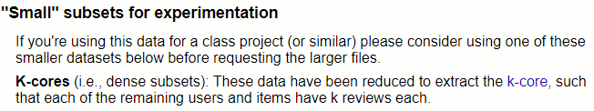
2. Data & descriptive statistics (1/5)
Amazon reviews data
Data structure detail
The review dataset we chose was the 5-core dataset and not the entire dataset which is a filtered list from the larger dataset
filtered the data to remove duplicate reviews , and the tablet products. This resulted in the dataset being reduced to 63,919 records and consisting of our desired cell phone reviews
Reviews data | reviewerID - ID of the reviewer, e.g. A2SUAM1J3GNN3B asin - ID of the product, e.g. 0000013714 reviewerName - name of the reviewer vote - helpful votes of the review style - a disctionary of the product metadata, e.g., "Format" is "Hardcover" reviewText - text of the review overall - rating of the product ( categorical variable with values among 1, 2, 3, 4, 5) summary - summary of the review unixReviewTime - time of the review (unix time) reviewTime - time of the review (raw) image - images that users post after they have received the product
Products metadata | asin - ID of the product, e.g. 0000031852 title - name of the product feature - bullet-point format features of the product description - description of the product price - price in US dollars (at time of crawl) imageURL - url of the product image imageURL - url of the high resolution product image related - related products (also bought, also viewed, bought together, buy after viewing) salesRank - sales rank information brand - brand name categories - list of categories the product belongs to tech1 - the first technical detail table of the product tech2 - the second technical detail table of the product similar - similar product table

Slide 5
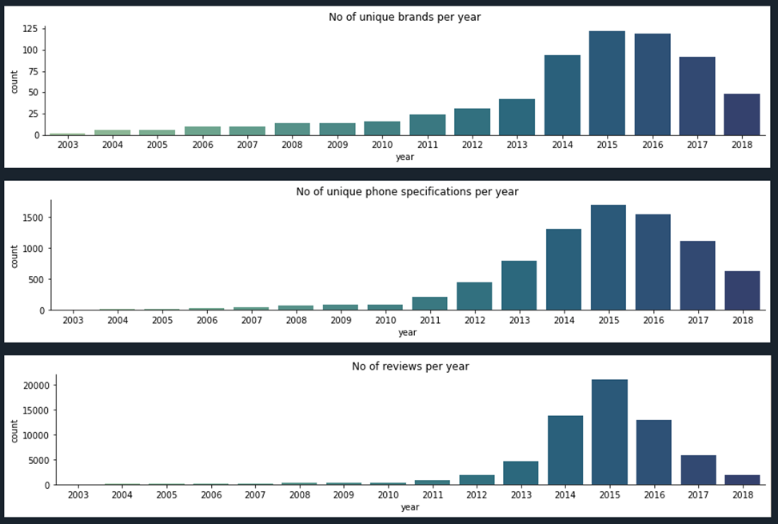
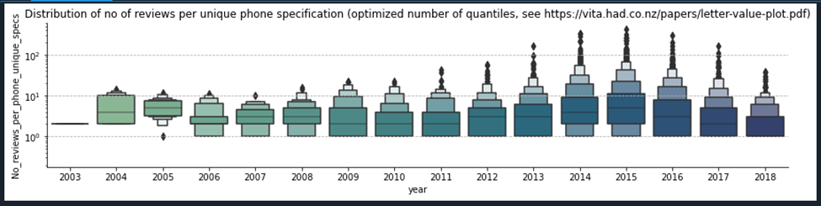
2. Data & descriptive statistics(2/5)
Brands, Phone Specs, Number of Reviews per year
Avg. Number of Reviews per phone by year
As time passes the number of reviews, brands and phone specs grows steady and hits a plateau in 2015. From 2016 to Sep 2018, when the last review was available, the numbers decreased.
The average number of reviews per phone spec follows the same pattern with 2014-2016 the “reviews enthusiast” years

Slide 6
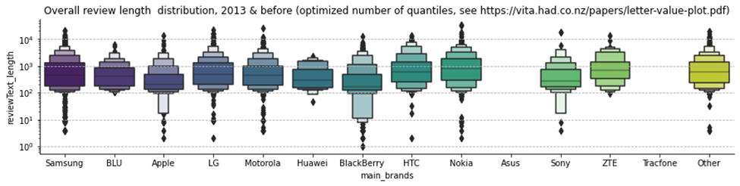
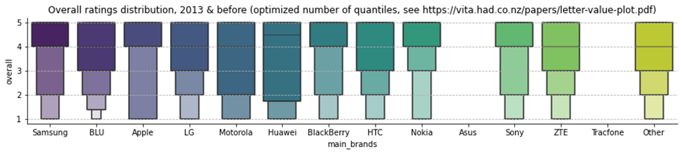
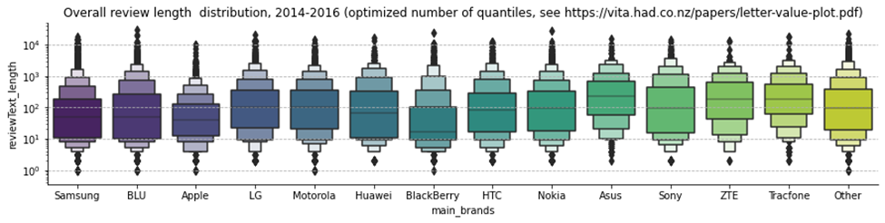
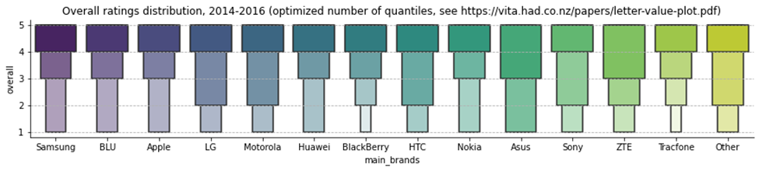
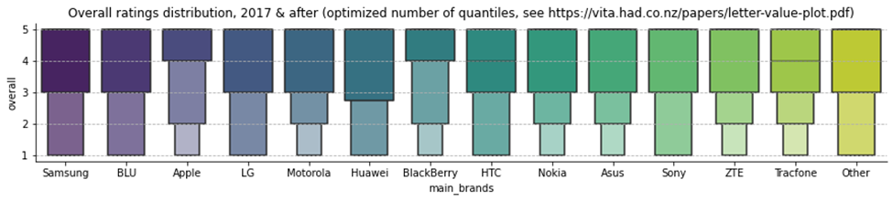
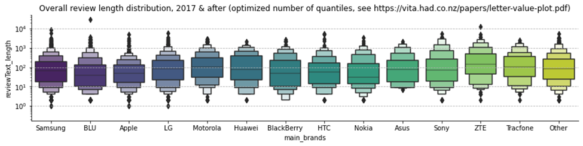
2. Data & descriptive statistics (3/5)
Overall User Ratings
Phone Reviews Text length(log scale)
As time passes the number of reviews, brands and phone specs grows steady and hits a plateau in 2015. From 2016 to Sep 2018, when the last review was available, the numbers decreased. The ratings are concentrated in the five star category
before 2014 the reviews tended to be longer while after 2013 the distribution of the length of the review tests seems to have stabilized

Slide 7
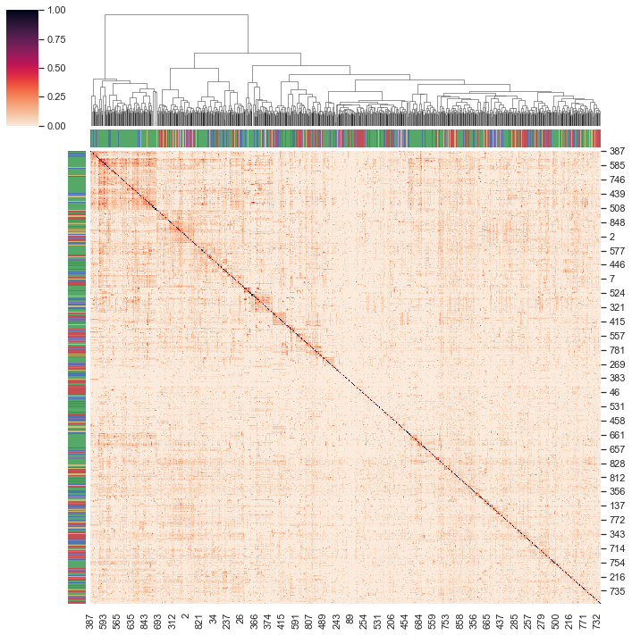
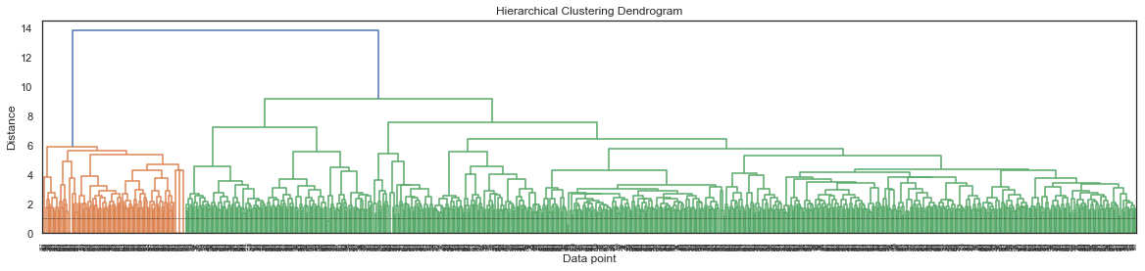
2. Data & descriptive statistics (4/5)
Overall rating and review text clustering
One can observe that there tends to be a clustering based on text for reviews on the 5 star rating (green color in the vertical and horizontal bar)
Note: Due to memory restrictions the data includes only reviews in 2018.

Slide 8

2. Data & descriptive statistics (5/5)
Grammar & technical terms issues
spelling errors and abbreviations (example: “Had a defective camera. Needed tk be replaced.”)
Spanish text (“Excelente Gracias”)
To account for the above we have manually intervened and created a dictionary for certain words that occur among the most frequent 1000 words
We have not accounted for technical terms. For example: ”1mb”, ”62MB” are terms associated to memory and should be grouped.

Slide 9
3. Predicting the overall score using review text(1/4)
Scope
Methodology
For pedagogical reasons as well as to test prediction robustness to model choice we have used the following methodologies
Logistic regression ( elastic net penalty with 0.5 L1 weight)
Random Forest
LSTM
LSTM & CNN
LSTM & CNN with pre-trained GLOVE embedding
Our preference is the logistic regression parametric model, mainly for ease of interpretability and ease of implementation of a weighting function to account for the unbalanced ratting in the reviews sample (it does not need re-sampling or re-grouping of predicted variables to balance the available data).
Approximately 4000 reviews are included. The study:
a) uses reviews starting in 2017, choice motivated both by:
the short lifespan of a phone which makes less similar the phones in 2018 with the phones in 2014b and
laptop performance limits
b) includes reviews larger than 50 characters and smaller than 1500 characters , choice informed by the boxenplot graph of review text length distribution by year
Analyze user text reviews versus phone overall ratings and identify key words/themes that are related to customers rating well a product, as well as the issues that are causing customers to think negatively of a product.
We note that the methology proposed does not make a distinction between sentiment terms and technical terms (this would need a separate dictionary for senytiment words)

Slide 10
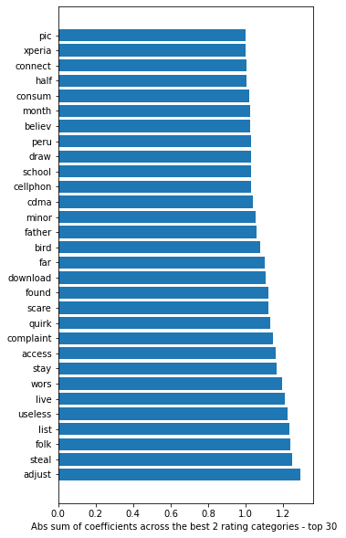
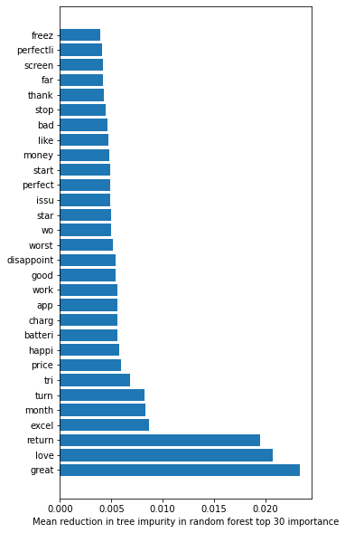
3. Predicting the overall score using review text(2/4)
Logistic regression – in sample results
Random forest - in sample results
Precision: [0.88 0.76 0.79 0.72 0.95]
Recall: [0.91 0.95 0.91 0.83 0.82 ]
Top 30 important words
Precision: [0.98 1. 1. 1. 0.62]
Recall: [0.62 0.38 0.36 0.30 1. ]
Top 30 important words
Note: Due to time constraints we have not separated the data into a train and a test subsamples which poses challenges as the vocabulary in the train set does not match exactly the vocabulary in the test set.

Slide 11
Rating prediction using review text(2/4)
LSTM
LSTM & CNN
LSTM & CNN with pre-trained GLOVE embedding
Train on 2832 samples, validate on 1888 samples
Epoch 1/3
2832/2832 [==============================] - 4s 2ms/sample - loss: 0.6203 - accuracy: 0.6480 - val_loss: 0.5360 - val_accuracy: 0.7394
Epoch 2/3
2832/2832 [==============================] - 2s 855us/sample - loss: 0.4348 - accuracy: 0.7987 - val_loss: 0.4992 - val_accuracy: 0.7797
Epoch 3/3
2832/2832 [==============================] - 2s 864us/sample - loss: 0.3495 - accuracy: 0.8460 - val_loss: 0.5321 - val_accuracy: 0.7738
Using LSTM versus Logistic regression does not lead to significant improvements in accuracy .
Train on 2832 samples, validate on 1888 samples
Epoch 1/3
2832/2832 [==============================] - 2s 813us/sample - loss: 0.6594 - accuracy: 0.6102 - val_loss: 0.6228 - val_accuracy: 0.7055
Epoch 2/3
2832/2832 [==============================] - 1s 267us/sample - loss: 0.4977 - accuracy: 0.7609 - val_loss: 0.5350 - val_accuracy: 0.7521
Epoch 3/3
2832/2832 [==============================] - 1s 277us/sample - loss: 0.3711 - accuracy: 0.8259 - val_loss: 0.6503 - val_accuracy: 0.7373
Adding the CNN layer does not lead to significant improvements in accuracy.
Loaded 395832 word vectors from glove_6B_100d mapping.
Train on 2832 samples, validate on 1888 samples
Epoch 1/3
2832/2832 [==============================] - 3s 916us/sample - loss: 0.6381 - accuracy: 0.6317 - val_loss: 0.5979 - val_accuracy: 0.6806
Epoch 2/3
2832/2832 [==============================] - 1s 250us/sample - loss: 0.5654 - accuracy: 0.7115 - val_loss: 0.5796 - val_accuracy: 0.7002
Epoch 3/3
2832/2832 [==============================] - 1s 253us/sample - loss: 0.5165 - accuracy: 0.7472 - val_loss: 0.6342 - val_accuracy: 0.6917
Using Glove embedding does not lead to significant improvements in accuracy .
Note: Due to time constraints, to account for the imbalance in the overall rating data we have grouped together ratings below 5 stars.

Slide 12
Conclusions & further research
Conclusions
We have analyzed an Amazon phone reviews dataset.
The logistic regression seems to work sufficiently well and be the most parsimonious model for variables reduction/ feature selection for phone reviews vs overallrating data since 2017
Challenges : has been to address the language misspelling and foreign language issues
Further research
Explore if other variables in the Amazon data can be used such as the number of helpful votes of the review
Control for phone spec or brand
Explore use of bigrams and trigrams
Enhance the English word corrections dictionary and research resources for detection and translation from Spanish
Pre-process technical terms and abbreviations which needs to be researched more in dept and applied before any text tokenization
Explore if clustering is appropriate to determine comparable phones of same or different brands for a better brand positioning in a certain phone type class
For LSTN & CNN explore packages and methods for visualizing feature importance and applicable variable reduction techniques

Slide 13
Refrences
Jianmo Ni, Jiacheng Li, Julian McAuley, “Empirical Methods in Natural Language Processing (EMNLP)”, 2019, https://nijianmo.github.io/amazon/index.html, http://cseweb.ucsd.edu/~jmcauley/pdfs/emnlp19a.pdf
https://seaborn.pydata.org/examples/structured_heatmap.html
https://newscatcherapi.com/blog/spacy-vs-nltk-text-normalization-comparison-with-code-examples

